Slide 1



Motodynamiki
Data Analysis

Slide 2


1. Data Presentation
The given data were a total of 50 variables on 5000 observations containing both quantitative and qualitative data.
However, some adjustments were needed to be done in order to facilitate the analysis.
Specifically, some variables were initially removed and some rows as well that contained missing values that could not be easily obtained.

Slide 3
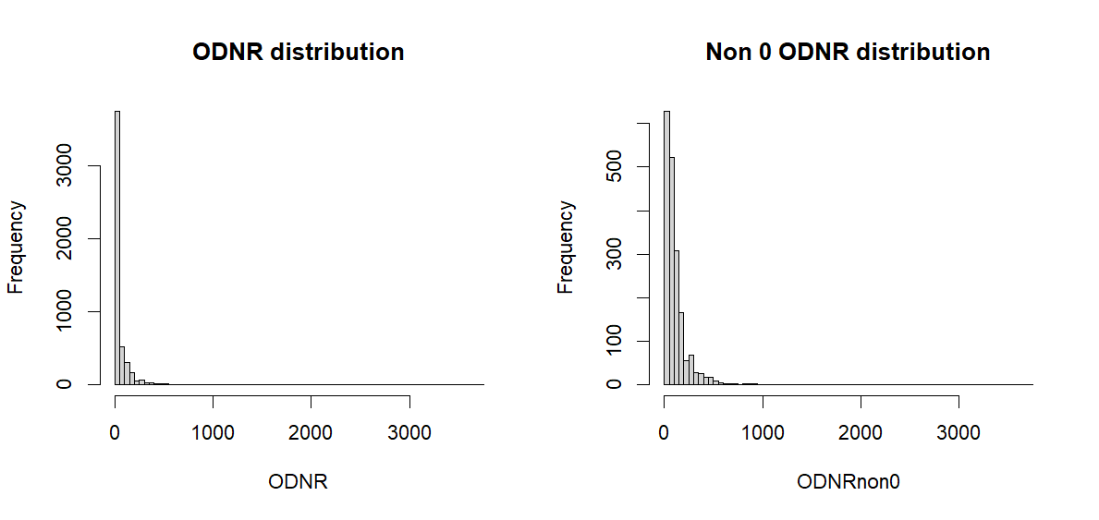
2.1. Explanatory Data Analysis
On the EDA part a distinction was made between the ODNR (On-Desk Net Revenue) variable and the rest, because the ODNR considered to be the explanatory variable of the analysis.
Here we see the empirical distribution of ODNR with and without zeros.

Slide 4
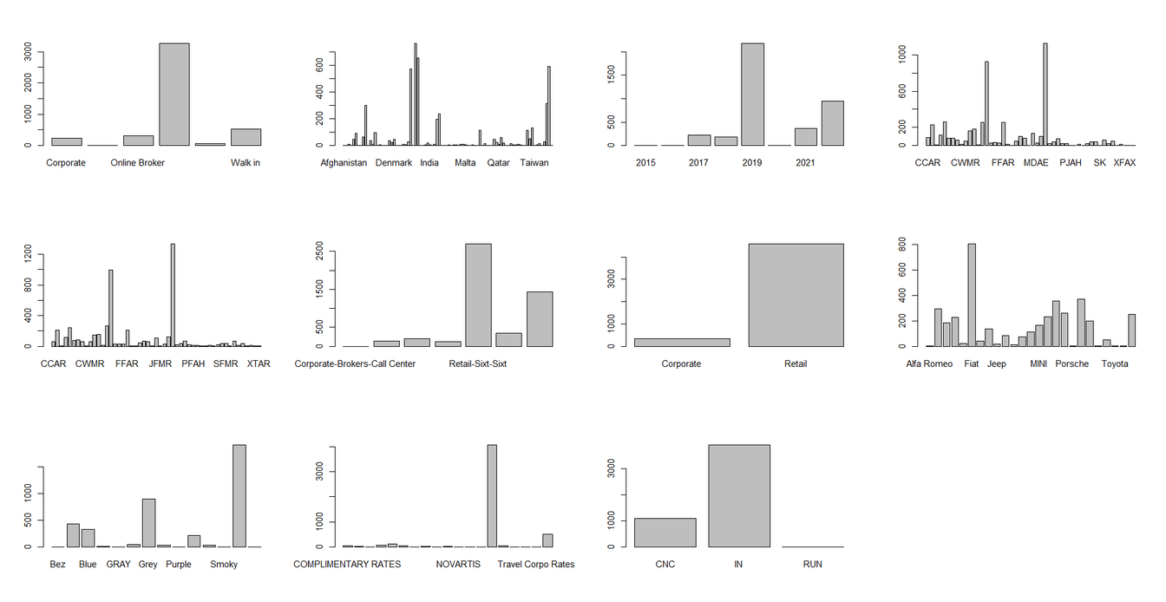
2.2. Explanatory Data Analysis
In this image, we get some brief information about how the rest variables are distributed.

Slide 5
Some interesting facts about the EDA analysis that are worth mentioning are the following:
Interesting
Facts
01
02
03
Increments
ODNR
Countries
Some Increments were selling with much higher frequency
Some observations were higher than 1000€
The data contain car rentals from over 150 countries!

Slide 6
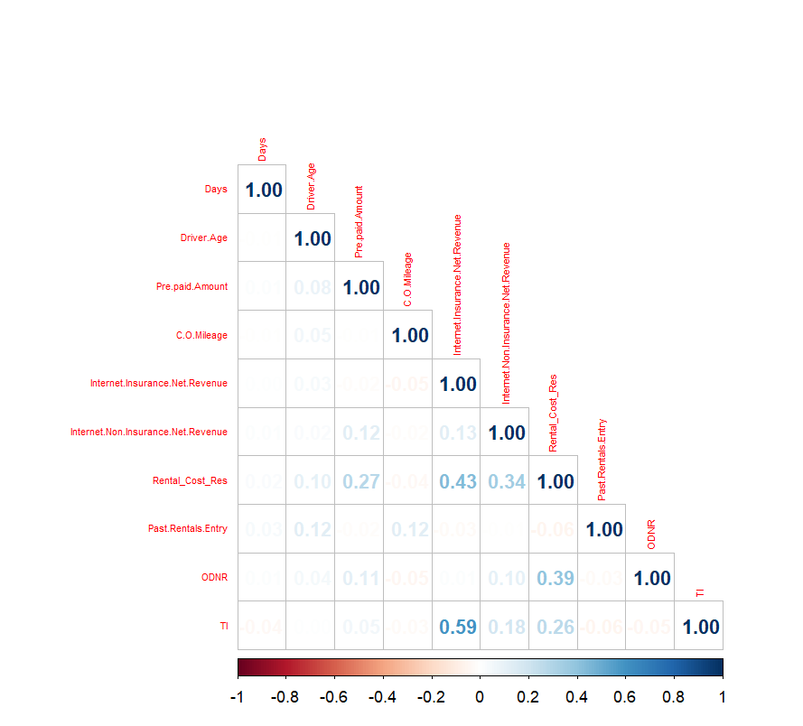
Pairwise
Comparisons
In order to test if there is any correlation between the data, we can check the graphs of the correlation plots for the quantitative, and the ANOVA results for the qualitative data.

Slide 7
Model Selection
In order to get the best model we run a stepwise process and based on AIC we can select the optimum one.
A log transformation was implemented to the data because it gives better properties to the outcomes.
IThe outcome of the model undergoes the assumptions of a good multiple regression model.
Note, we use forward selection here, starting from the Null model because we have many data in the model

Slide 8
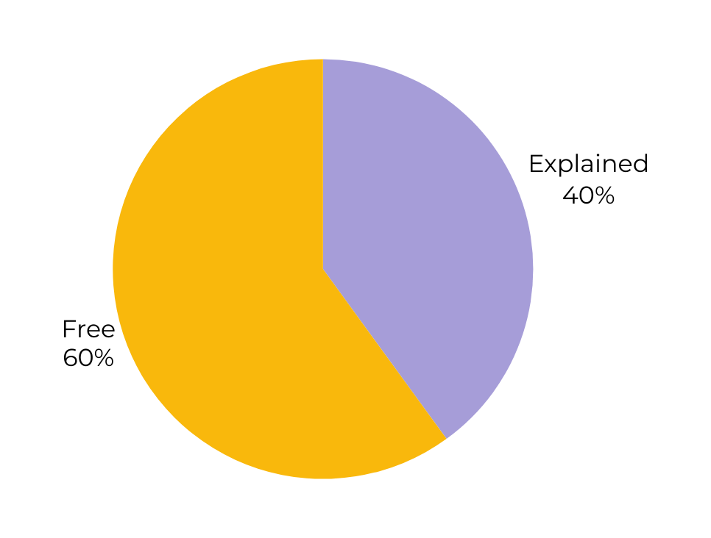
Model’s Variability
After running the model, the total variance that is explained is approximately equal to 40%

Slide 9

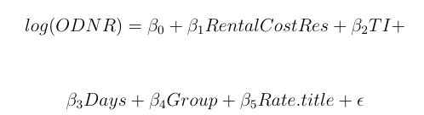
Best model
The best model that the analysis gives us is this:
However, we are going to use the following for the modeling:

Slide 10

THANK YOU

